Slide 1

ANALYSIS OF FACTORS INFLUENCING STUDENT’S PERFORMANCE
PRESENTED BY: Paulina Iliya
06/04/2024

Slide 2
INTRODUCTION
Education is one the fundamental infrastructures of development and it is a privilege that a state must guarantee to its citizens.
Students' Academic Performance is vital for assessing a student's standing within an institution. It makes it possible for academic staff, educational administrators, and decision-makers to precisely evaluate students taking various courses.

Slide 3

To analyze some important factors influencing student’s academic performance with the aim of understanding its impact on student’s total scores.

Slide 4
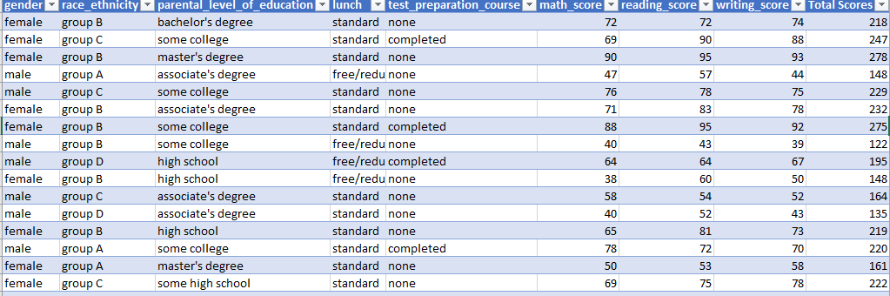
ABOUT DATA
Dataset for the analysis was collected from a secondary source (www.Kaggle.com) with a sample size of 1000, which consists of records of gender, parents' educational background, lunch, test preparation, total scores etc.

Slide 5
METHODOLOGY
The analysis was carried out using Microsoft Excel.
01
Raw dataset was clean and merged using power query.
02
Pivot table was used to perform calculations.
03
Pie charts and Bar charts were used for visualization.
04

Slide 6
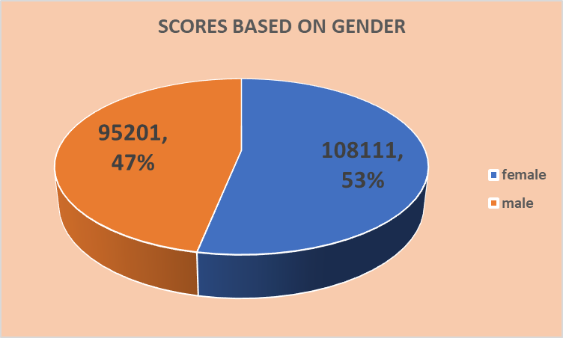
RESULT AND DISCUSSION

Slide 7
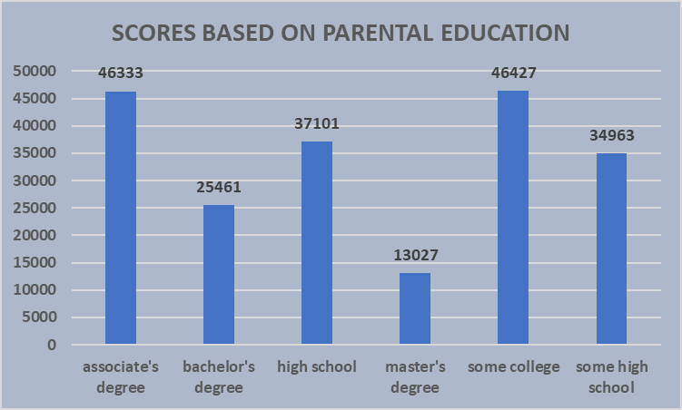
RESULT AND DISCUSSION

Slide 8
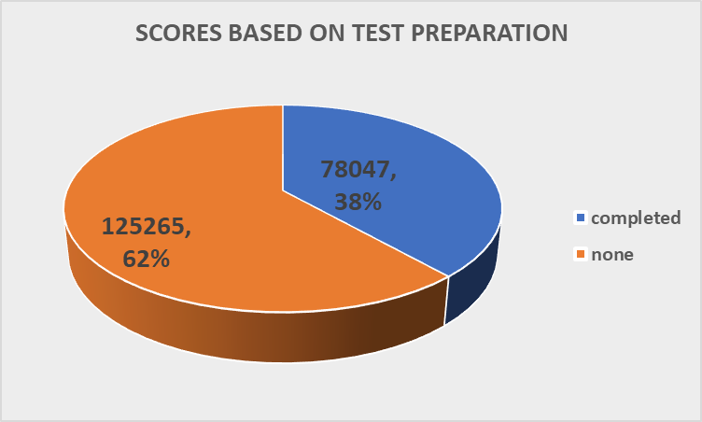
RESULT AND DISCUSSION

Slide 9
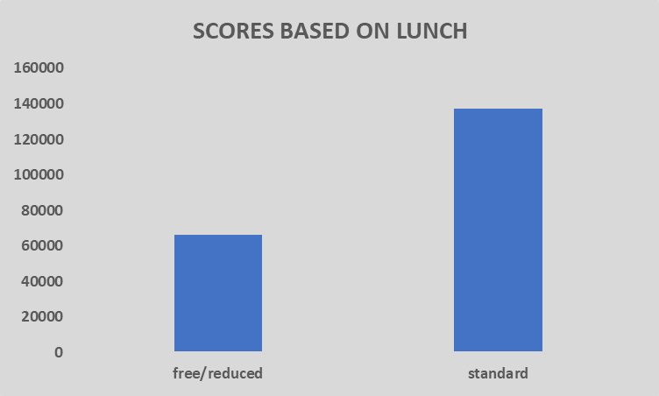
RESULT AND DISCUSSION

Slide 10
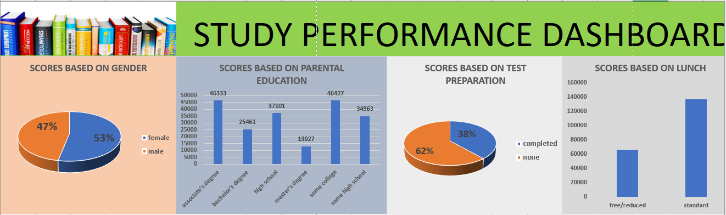

Slide 11
RECOMMENDATION
Success in school requires much more than intelligence alone and high scores require study and hard work. Hence the gender with low score should be encourage to be more dedicated to whatever they do.
Preparation requires understanding so as to be productive.
Students should be encourage to eat lunch in order to avoid not only low scores but sicknesses like ulcer.
Parent with high level of education should give attention to their own children’s education.

Slide 12

CONCLUSION
Student performance can be affected with some factors either positively or negatively.

Slide 13
Thank you
for patiently
listening

